Slide 1
A sonar echo returns to a boat in ocean 2.6 s after being emitted. What is the depth of the ocean at the location of the boat? (Assume that the speed of sound in ocean water is 1540 m/s).

Slide 2
What is the wavelength of the 96 MHz (M = 10⁶) radio waves? Assume a speed of light o 3.0 x 10⁸ m/s.
Express the numeral of your answer in SI units with 3 or more significant figures.

Slide 3

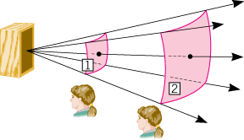
Sound Intensity
The sound intensity I is defined as the sound power P that passes perpendicularly through a surface divided by the area A of that surface:
P. A 75 W speaker emits sound radially and uniformly in all directions. What will be the intensity of sound in W/m² at 3.5 m from this speaker?

Slide 4

16. What sound intensity level in dB is produced by earphones that create an intensity of 4.00×10⁻²W/m²? I₀ = 1.00×10⁻¹²W/m²

Slide 5
P34. A commuter train blows its 200-Hz horn as it approaches a crossing. The speed of sound is 335 m/s. (a) An observer waiting at the crossing receives a frequency of 208 Hz. What is the speed of the train? (b) What frequency does the observer receive as the train moves away?

